Slide 1
Smithgall Woods Park Website
Project Update
MIST7591E – MBT Project II
Andrea Castresana
Jennifer Lazo
Alexander Couch
Clark Williams
Eliseo Santos
March 28, 2018

Slide 2
Overview
Project Background
Web Hosting Cost Comparison
Site & App Demo – Beta Version
Test Plan
Alternate Solution – App in WordPress
Project Schedule
Next Tasks

Slide 3
Project Background
Problem
Difficult to update/maintain site and Volunteer app
Outdated PHP, WP themes and plugins
Degraded site security
Solution
Rebuild site using current WordPress/PHP
Continue using 1&1.com web host (instead of Bluehost)
Establish Admin Documentation & Video Tutorials
Train FSGW Reps
Notes:
Criteria for website hosting:
Code must be accessible and portable
Cost must be below $20
Site security must be include SiteLock and SSL Certificate

Slide 4
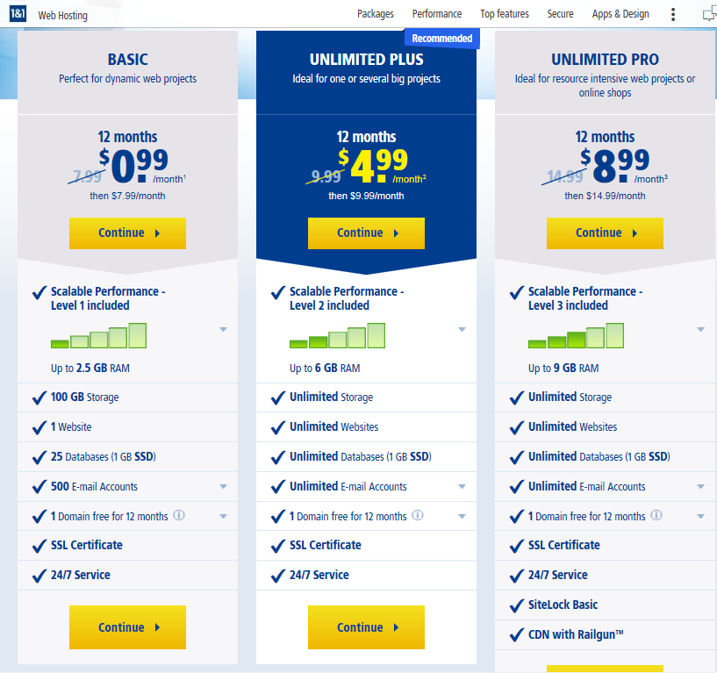
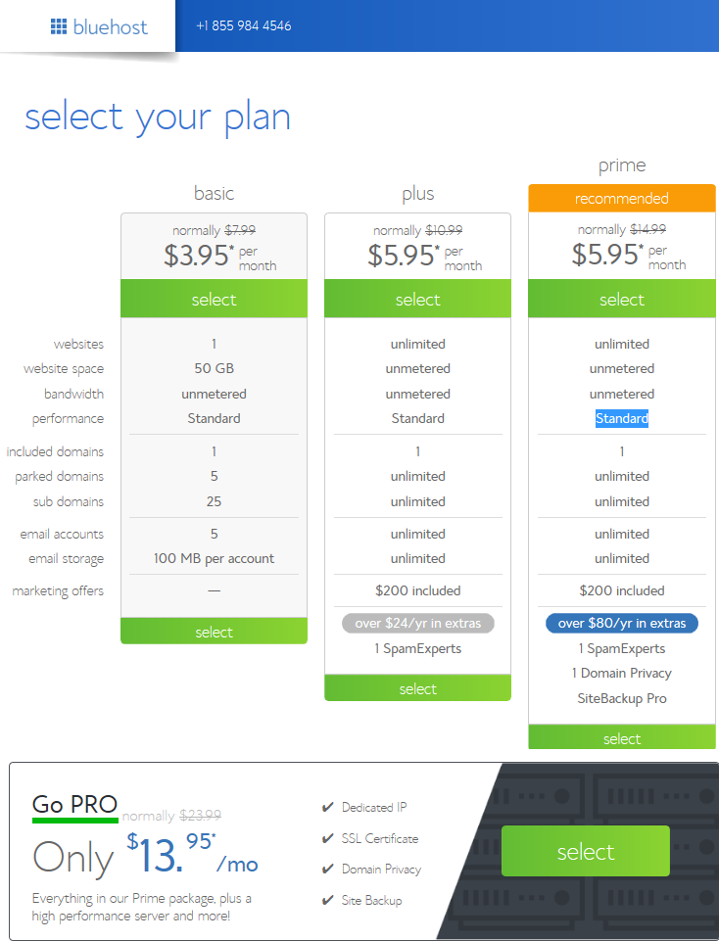
Web Hosting Cost Comparison
1and1.com - $8.99/mo ($14.99 after 1yr)
Bluehost - $13.95/mo ($23.99 after 1yr)

Slide 5
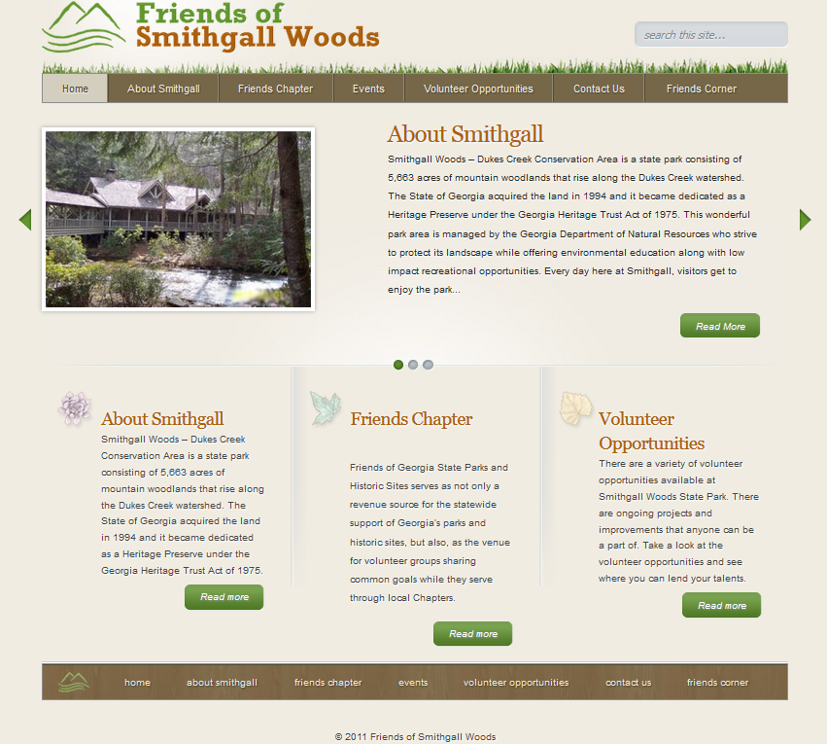
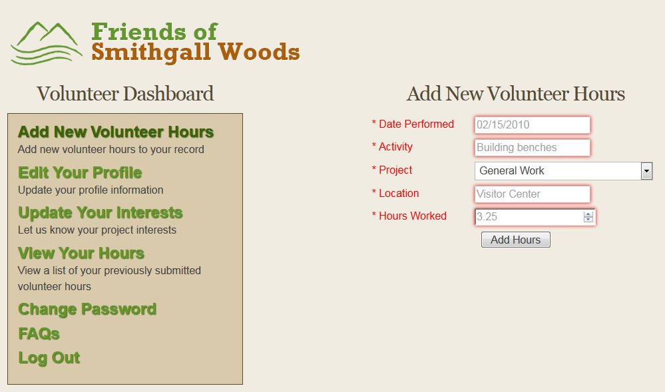
Current Site/App
Difficult to update page contents/images
App breaks down with later versions of PHP

Slide 6
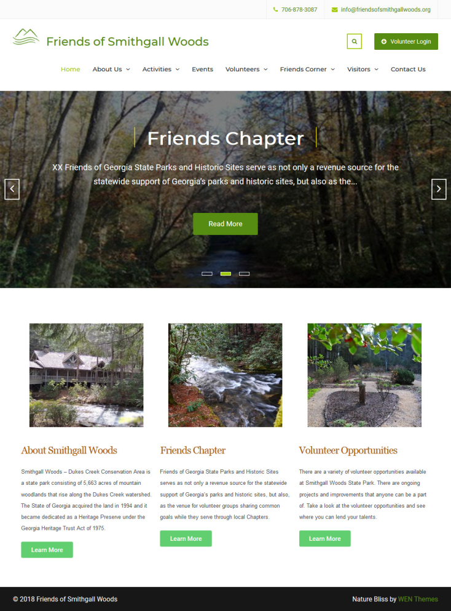
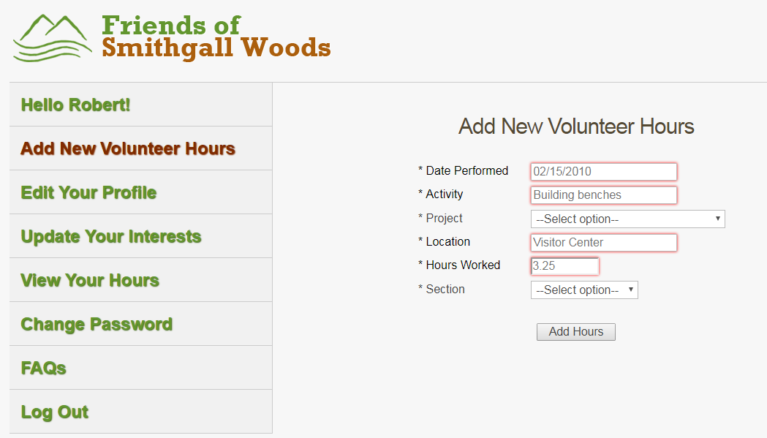
Site & App Demo – Beta Version
Improved Site and Volunteer Hours App
https://www.friendsofsmithgallwoods.org/test/alpha
https://www.friendsofsmithgallwoods.org/test/alpha/volunteer

Slide 7
Test Plan
Website Test Cases
Case #1: Site Navigation Menu and Hyperlinks
Case #2: Drop-down Windows in Events Page
Case #3: Tabs Widget in Roads & Trails Page
Case #4: Page Content and Image Update
App Test Cases
Case #1: App Navigation Menu and Hyperlinks
Case #2: Registration and Login Functionalities
Case #3: Create Record
Case #4: Read Record
Case #5: Update Record
Case #6: Delete Record

Slide 8
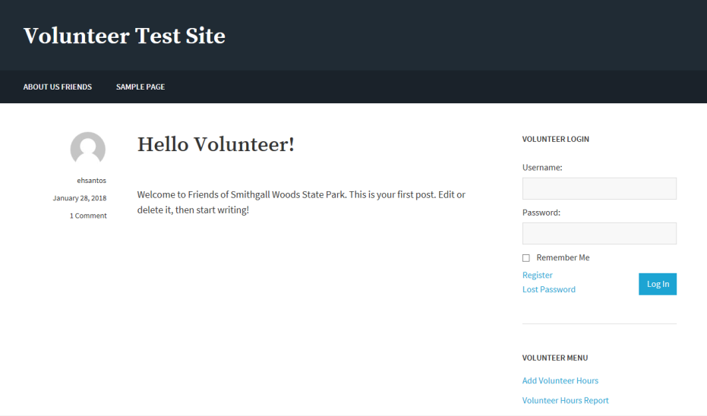
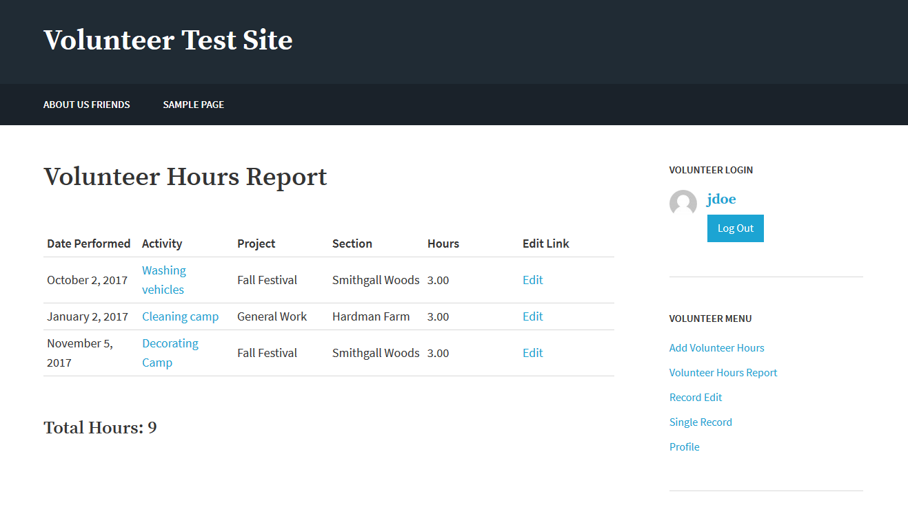
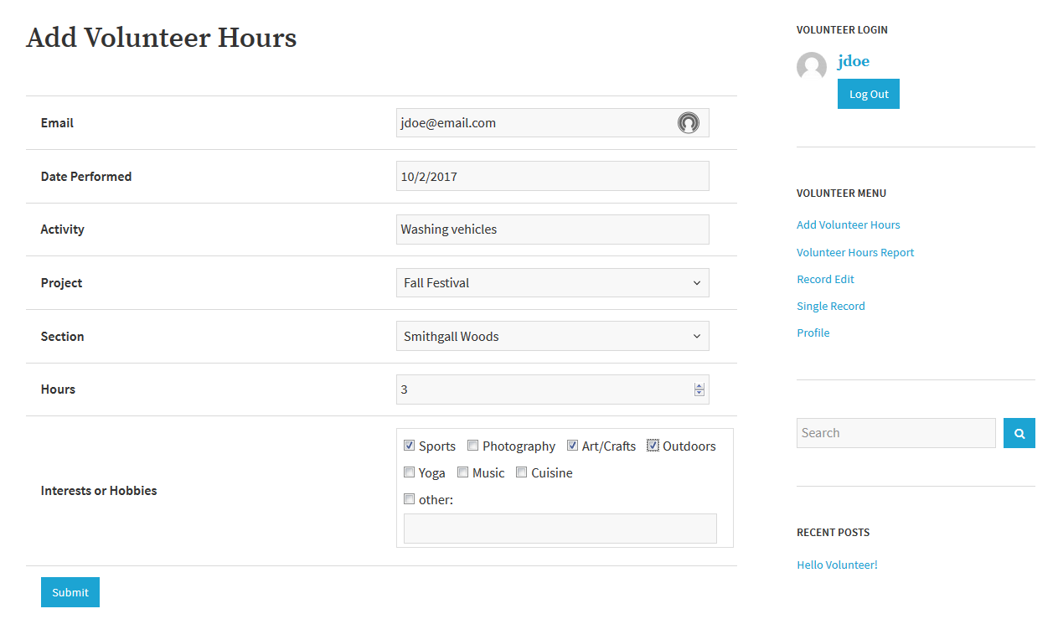
Volunteer App in WordPress
Alternate Solution using free plugins
Demo Site: www.friendsofsmithgallwoods.org/test/eliseo/
Notes:
This solution is pretty much done as it is able to support the Create, Read, Update, and Delete functions with each registered user of the app. We’re just working on the “Total Hours” function using a PHP script on the Volunteer Hours Report page and cleaning up the rest of the pages for our final presentation.

Slide 9
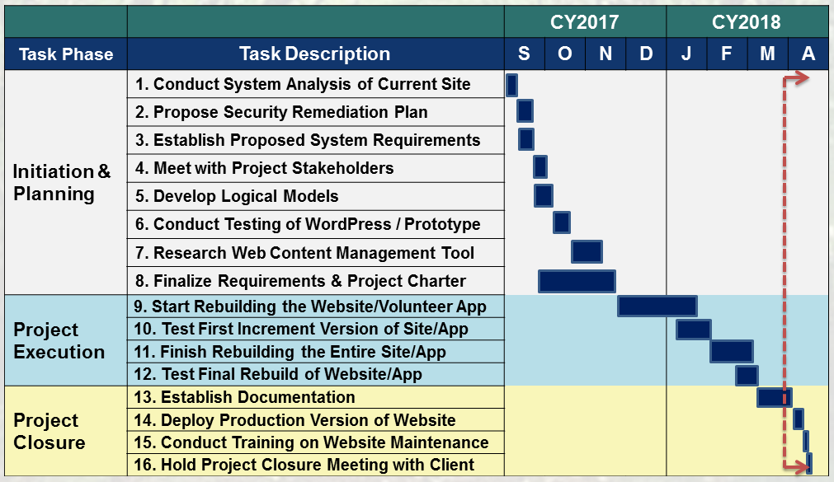
Project Schedule
Notes:
xx

Slide 10
Next Tasks….
Finish Documentation & Video Tutorials
Deploy Website & App on ~April 4th
Schedule Training Session with Art
Set up Admin Reporting Site by Section
SGW & Hardman Farm
PHPRunner Tool
Notes:
Briefly talk about the documentation and video tutorials that our team is already in the process of developing

Slide 11
Questions

Slide 12
BACKUPS

Slide 13

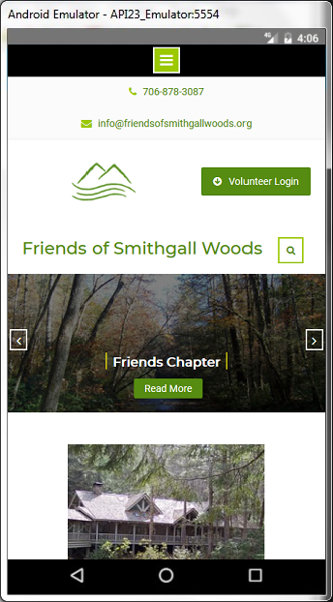
Desktop & Mobile Views

Slide 14
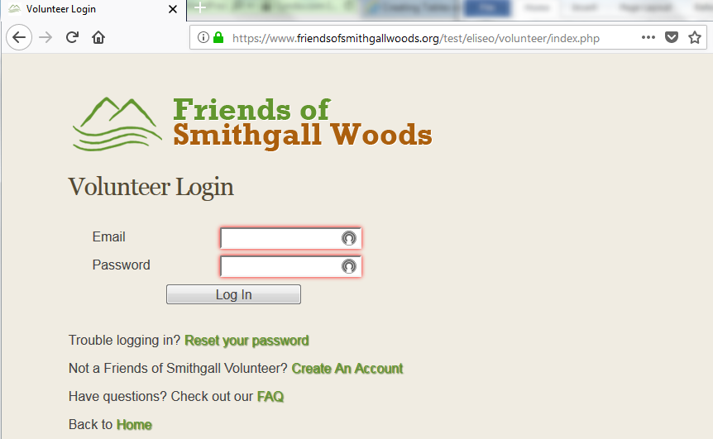
Existing Volunteer App
Stand-alone app linked from WP site

Slide 15
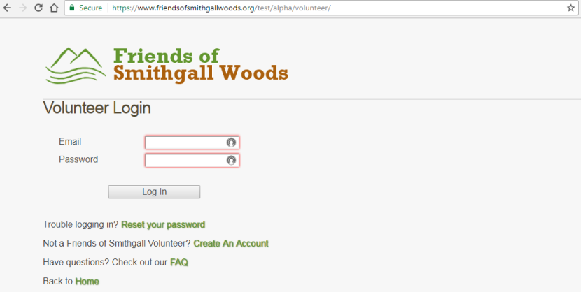
Improved Volunteer App
Added Left Sidebar Menu
Added Login Name in each page
Added Section Field for Hardman Farm & SGW
Updated app from PHP 5.6 to 7.2
Notes:
Our team has been working on meeting the user requirements for mobile capability of the site and app.
Since the client had chosen for our team to rebuild the existing app as stand-alone, we’ve made the following improvements to it:
We added the Login Name in each page of the app
We created another field that identifies volunteer hours for Hardman Farm
We also updated the app to run on PHP7.X and future PHP updates by resolving the obsolete MySQL functions on these later versions of PHP.
And we needed to move the menu from the top bar to the left sidebar to make it mobile-friendly. The top menu bar did not work well with mobile devices.

